Slide 1

Department of Information Technology
“CAREBOT : A PATIENT HISTORY AUTOMATION”
TEAM MEMBERS
ALEX RAYER A [21UIT009]
GUNAAL T [21UIT044]
VASANTH R [21UIT175]
Under the Guidance of
MISS. A.SOWBARNIKA
ASSISTANT PROFESSOR

Slide 2
Agenda
Abstract
Introduction
Motivation
Literature Survey
Exisisting System
Problem Statement
Proposed System
Architecture Diagram
Modules Identified and Algorithm
Implementation Work
References
Publication

Slide 3
Abstract
The practice of gathering a patient's medical history has been fundamental to healthcare for centuries, serving as the basis for accurate diagnoses and effective treatment plans.
Traditional face-to-face consultations often result in incomplete medical histories due to time constraints and communication barriers.
Carebot history taking systems have emerged as a transformative solution, leveraging technology to enhance data collection and patient engagement.
These systems allow patients to complete questionnaires or surveys before their appointments, enabling them to provide comprehensive medical histories at their own pace.

Slide 4
Introduction
In the evolving landscape of healthcare, the need for efficient and accurate patient data collection has become increasingly critical.
Traditional methods of gathering patient information often involve time-consuming manual processes and are prone to errors and inconsistencies.
To address these challenges, automated patient data collection systems have emerged as a transformative solution.
The systems leverage advanced technologies such as data analytics, and artificial intelligence to streamline and enhance the process of collecting, storing, and managing patient information.

Slide 5
Motivation
Inadequate Patient Histories:
Traditional face-to-face consultations often result in incomplete patient histories due to time constraints and communication barriers. Inadequate histories can lead to misdiagnosis, inappropriate treatment plans, and increased risk of medication errors and adverse drug reactions.
Shortage of Healthcare Professionals :
India, like many other countries, faces a severe shortage of doctors and healthcare providers. The high patient-to-doctor ratio makes it challenging to dedicate sufficient time to each patient, affecting the quality of history-taking and overall care.
Efficiency in Healthcare Delivery:
The healthcare system is under constant pressure to improve efficiency. Carebot history-taking systems can streamline the process, allowing healthcare providers to focus on addressing specific concerns during consultations, thus optimizing the use of limited time and resources.

Slide 6
Literature Survey
S.NO. | Title | Author and Year | Techniques and Algorithms | Pros | Cons
1. | Pre-consultation history taking systems and their impact on modern practices: Advantages and limitations. | Gulnur Zhakhina1,2, Karina Tapinova. 28 Nov 2023. | It uses Naive Bayes Algorithm,Support Vector Machines (SVMs) and Random Forest Algorithm Used to identify red flags, and prioritize critical information for healthcare providers. | Pre-consultation history taking systems enable comprehensive data collection from patients.These systems provide healthcare providers with enhanced insights into patients' health status and medical history. | The digital divide can limit access to pre-consultation history taking systems for certain patient populations .Patients with limited health literacy may struggle to accurately complete questionnaires or surveys, leading to incomplete or inaccurate data.
2. | A Medical-History-Based Potential Disease Prediction Algorithm. | Wenxing Hong 1 , Ziang Xiong1 , Nannan Zheng1 , and Yang Weng 11 September 2019. | It uses various deep learning techniques like Recurrent Neural Networks (RNNs), Convolutional Neural Networks (CNNs), Autoencoders, Long Short-Term Memory (LSTM) networks. | The integration of healthcare big data analysis with deep learning technology for potential disease prediction has several advantages, including improved accuracy in identifying patterns, enhanced patient outcomes through early detection, the potential for personalized medicine, and reduced delays in treatment. | It also presents disadvantages such as high computational costs, data quality issues, privacy and security concerns, and Deep learning algorithms can be difficult to interpret, making it challenging to understand why a particular prediction was made.

Slide 7
S.NO. | Title | Author and Year | Techniques and Algorithms | Pros | Cons
3. | Framework for Implementation of Personality Inventory Model on Natural Language Processing with Personality Traits Analysis | P. William; Yogeesh N; Vishal M Tidake. 5 March 2022. | It uses several algorithms like SVM ,Decision tree ,Naive bayes ,Logistic regression ,Random forest and techniques like Bags of Words (using sklearn CountVectorizer) GloVe (pre-trained word embeddings). | Multi-model deep learning architectures and pre-trained language models like BERT and RoBERTa can improve the accuracy of personality prediction. Automated prediction methods can process large amounts of data quickly, making it possible to analyze a big number of users. | The accuracy of personality prediction depends on the quality of the data used to train the models, which can be affected by biases and noise. Analyzing user activity and textual content raises concerns about data privacy and the potential for misuse.
4. | Implementation of Chatbot in Online Commerce, and Open Innovation | María D. Illescas-Manzano , Noé Vicente López . 1 March 2023. | It uses algorithms like NLP ,Rule-based system ,Lead scoring ,Market automation ,Chat marketing and Lead generation strategies like personalised offers and Nurturing leads and also include Data analysis and Messenger marketing. | The chatbot has a positive impact on lead capture compared to traditional methods. The chatbot is an agile and powerful tool for obtaining information about consumers. The chatbot facilitates two-way communication, enabling companies to perform marketing actions more effectively | The study only focuses on the implementation of a chatbot via Facebook Messenger using the ManyChat platform. Future research could compare the effectiveness of the ManyChat platform with other chatbot platforms. Further research is needed to evaluate the long-term impact of chatbot implementation on lead capture and sales.

Slide 8
S.NO. | Title | Author and Year | Techniques and Algorithms | Pros | Cons
5. | Anticipating User Interactions in customer care dialogue system | Alessandro Mazzei;Luca Ansemia. 5 October 2022. | It has some following algorithms and techniques like Symbolic data to text generation , Contextual relational knowledge analysis and Offline human evaluation to give the output of GEN-DS and compare with the original system. | GEN-DS generates more relevant answers, improving the utility of the interaction. It provides necessary information to users, increasing the necessity of the interaction. It can lead to faster query resolution, improving the quickness of the interaction. | GEN-DS may struggle to understand user requests with complex grammar or semantics. It may not fully understand the context of the user's request, leading to misunderstandings or misinterpretations. It may not be able to adapt to changing user needs or preferences, limiting its flexibility and ability to handle unexpected requests.
6. | Designing and Implementing Conversational Intelligent Chat-bot Using Natural Language Processing | Asoke Nath , Rupamita Sarkar , Swastik Mitra, Rohitaswa Pradhan. 15 May 2021. | It uses following algorithms and techniques like Symbolic NLP ,Neural NLP ,Transformer-based architecture ,Deep neural network to retrieval-based model for NLU and NLG. | The chatbot can engage in discussions on a wide range of topics, making it versatile and adaptable to various user interests.The use of deep learning models allows the chatbot to scale effectively, handling multiple conversations simultaneously without degradation in performance. | The chatbot may struggle with understanding user inputs or context, potentially leading to misinterpretations or irrelevant responses.The performance of both generative and retrieval-based models heavily relies on the quality and quantity of the training data, which can be challenging to obtain.

Slide 9
S.NO. | Title | Author and Year | Techniques and Algorithms | Pros | Cons
7. | Assessing Performance of Cloud-Based Heterogeneous Chatbot Systems and A Case Study | Ganesh Reddy Gunnam. 6 May 2024. | It uses algorithms and techniques like Split-window method ,Load testing ,Automated protocol chatbot development framework , Real user and Simulated user testing , and also includes NLP. | Cloud-based chatbots eliminate the need for on-premise infrastructure, reducing costs associated with hardware, software, and maintenance. Cloud-based chatbots can be accessed from anywhere, at any time, and on any device, making it easier to manage and maintain the chatbot. | Cloud-based chatbots require a stable internet connection to function, which can be a problem in areas with poor connectivity. Cloud-based chatbots are vulnerable to security risks, such as data breaches and cyber attacks, if not properly secured. Cloud-based chatbots can experience downtime, which can impact user experience and satisfaction.
8. | Emergency Medical Access Control System Based on Public Blockchain | Taisei Takahashi,Yan Zhihao,Kazumasa Omote. 28 August 2024. | It uses techniques and algorithms like Public-blockchain technology ,Tamper-proof and Biometric authentication ,Diffie-Hellman key exchange protocol , Security key exchange ,and Biometric authentication. | The system enables global access to medical records in emergency situations, ensuring that emergency doctors can access critical medical information regardless of the patient's location. The system provides secure sharing of medical records through a public blockchain, ensuring that health records are protected from unauthorized access. | The system relies on tamper-proof and biometric authentication capabilities, which may be vulnerable to technical failures or hacking. The use of a public blockchain may introduce potential security risks, such as 51% attacks or smart contract vulnerabilities. The system may raise concerns about patient privacy, as medical records are shared through a public blockchain.

Slide 10
S.NO. | Title | Author and Year | Techniques and Algorithms | Pros | Cons
9. | HealthAssistantBot: A Personal Health Assistant for the Italian Language | Marco Polignano. 8 June 2020. | It uses techniques and algorithms like Tokenization ,Named entity recognition ,Parts of speech tagging and Dependency parsing also includes Supervised ,Unsupervised and Deep learning . | HealthAssistantBot can improve patient care by providing personalized recommendations and monitoring treatments and health parameters. The virtual assistant can increase efficiency by automating tasks and providing quick access to health information. | The virtual assistant may have limited domain knowledge, which may affect its ability to provide accurate recommendations. The quality of the data used to train the machine learning models may affect the accuracy of the recommendations.
10. | An AI-Based Medical Chatbot Model for Infectious Disease Prediction | Mohd Asif Shah. 6 December 2022. | It uses techniques and algorithms like Tokenization ,Named entity recognition ,Neural network ,Supervised learning ,Unsupervised learning ,Parts of speech tagging and Dependency Parsing. | AI chatbot interaction and prediction models can analyze user input and provide accurate medical solutions, reducing the risk of human error. AI chatbot interaction and prediction models can process large amounts of data quickly and efficiently, reducing the time it takes to provide medical solutions. AI chatbot interaction and prediction models can provide medical solutions to patients in remote or underserved areas, improving access to healthcare. | AI chatbot interaction and prediction models may not have the same level of domain knowledge as human medical professionals, which can limit their ability to provide accurate medical solutions. AI chatbot interaction and prediction models may lack the human touch and empathy that patients need, which can lead to a negative patient experience.

Slide 11
S.NO. | Title | Author and Year | Techniques and Algorithms | Pros | Cons
11. | Design and development of a web-based patient management information system | Hendry Naufal Marbella, Izzat Aulia Akbart, Bambang Setiawan. 18 March 2023. | It uses various techniques and algorithms like Queue ,Scheduling ,Data retrieval and Remainder algorithm. It also include Database management ,API integration ,Response web design ,Agile development for flexibility and adaptability to change requirements. | The software provides patients with easy access to medical records, appointment scheduling, and reminders, improving patient engagement and satisfaction. The web-based interface allows patients and hospital staff to access the software from anywhere, at any time, improving accessibility and convenience. | The software may be prone to technical issues, such as bugs, glitches, and downtime, which can affect patient care and hospital operations. The software may require significant training and support for hospital staff, which can be time-consuming and costly. The software may require integration with existing systems and APIs, which can be complex and challenging.
12. | Enhancing Predictive Models to Lower Rehospitalization Risk: Utilizing Historical Medical Records for AI-Driven Interventions | Giada Confortala , Mika Takata , Naoaki Yokoi, and Masashi Egi. 15 May 2024. | It uses various techniques and algorithms like Explainable AI ,Historical data analysis ,Data-driven insights , It also include Predictive modeling ,SHARP ,Clustering ,Optimization and Similarity measurement algorithm are used in this concept. | The use of AI models can lead to more accurate predictions of patient readmission probabilities, allowing for better-informed discharge decisions. The targeted approach aims to lower readmission rates, improving patient outcomes and potentially leading to better health system efficiency. By preventing unnecessary rehospitalizations, the method can significantly reduce costs associated with patient care and hospital resources. | The effectiveness of the method is contingent on the availability and quality of historical medical records, which may vary across institutions. Integrating the proposed method into existing clinical workflows may require significant training and adjustments, which can be resource-intensive. The use of AI in clinical settings raises ethical concerns regarding patient privacy, data security, and the potential for bias in historical data.

Slide 12
S.NO. | Title | Author and Year | Techniques and Algorithms | Pros | Cons
13. | Secure System Medical Record with Blockchain System: Recchain Framework | Hendry Naufal Marbella, Izzat Aulia Akbart, Bambang Setiawan. 22 September 2024. | It uses the following techniques and algorithm like Data encryption and security ,Data storage and retrieval ,Consensus mechanism ,Ledger and Hash functions to secure the medical records .It also uses Public key Cryptography ,Access control mechanism to authorize the medical records. | Decentralized storage and blockchain technology ensure that medical records are secure and tamper-proof. Cryptographic hash functions and public-key cryptography provide an additional layer of security.Smart contracts and DAOs promote transparency and accountability in data management. The decentralized nature of RecChain enables seamless integration with various healthcare systems and platforms. | The decentralized and blockchain-based nature of RecChain can be complex and challenging to implement and maintain.The use of smart contracts and DAOs requires specialized expertise and infrastructure. The decentralized nature of RecChain can limit its scalability, particularly in large-scale healthcare systems. The use of blockchain technology can result in slower transaction processing times and higher costs.
14. | Identifying Facilitators and Barriers to Implementation of AI‑Assisted Clinical Decision Support in an Electronic Health Record System | Joseph Finkelstein, Aileen Gabriel, Susanna Schmer, Andrew Dunn. 29 August 2024. | It uses various techniques and algorithms like Supervised learning ,Unsupervised learning ,Regression analysis ,Decision tree ,Pattern recognition ,Association rule mining ,Ontology ,Rule based system ,API integration and Data warehousing. | AI-assisted CDS provides healthcare professionals with accurate and timely information to inform clinical decision-making.The use of machine learning algorithms and predictive analytics enables the identification of high-risk patients and prediction of patient outcomes. AI-assisted CDS can reduce medical errors and improve patient safety by providing healthcare professionals with real-time alerts and warnings. | AI-assisted CDS is only as good as the data it is trained on, and poor data quality can lead to inaccurate or biased results. The use of machine learning algorithms and predictive analytics requires large amounts of high-quality data to function effectively. The use of complex algorithms and models can make it difficult to identify the underlying reasoning and logic. The use of natural language processing and text analysis may not capture the full complexity of clinical decision-making.

Slide 13
S.NO. | Title | Author and Year | Techniques and Algorithms | Pros | Cons
15. | Knowledge, Attitudes, and Practices about Electronic Personal Health Records: A Cross-Sectional Study in a Region of Northern Italy | Giacomo Scaioli, Manuela Martell, Giuseppina Lo Moro1 . 9 April 2024. | It uses several techniques and algorithms like Survey research methodology ,Data analysis technique ,Satistical modeling ,Data visualization , Decision tree ,and Random forest algorithms are used to record personal data. | The study provides valuable insights into the awareness and acceptance of the EPHR among citizens in northern Italy.The findings can inform targeted campaigns to increase awareness and adoption of the EPHR. This information can be used to develop targeted interventions to improve health literacy and access to healthcare services. | The study's reliance on self-reported data may be subject to biases and limitations.The study's use of a cross-sectional design may not capture the complexities and dynamics of EPHR adoption and usage over time. The study's results may not capture the full range of benefits and challenges associated with EPHR implementation.
16. | Designing and Evaluating Online Health Consultation Interfaces: A Perspective of Physician-Patient Power Asymmetry | Lanyun Zhang , Jiani Zhan, Verena Kwok Wai Wan, And Yanbin Wang.4 September 2024. | It uses techniques and algorithms like NLP ,Human-centered design ,Wizard-of-oz design study ,Focus group and nominal brainstorming session ,Data analytics ,Cognitive walkthroughs ,Heuristic evaluation ,Machine learning algorithms ,Data thinking , User experience design used to promote patient-centered care and reduce power asymmetry. | By promoting patient empowerment and engagement, OHC platforms can lead to better health outcomes, as patients are more likely to adhere to treatment plans and make informed decisions about their health. OHC platforms that prioritize patient empowerment and user experience are more likely to gain a competitive advantage in the market. By designing UI that promotes patient-centered care, patients are more likely to feel empowered and in control of their health, leading to better health outcomes. | Designing and developing UI that addresses power asymmetry can be resource-intensive and costly. Addressing power asymmetry requires a deep understanding of user needs, behaviors, and motivations, which can be complex and challenging to navigate. OHC platforms must balance the needs of both patients and healthcare providers, which can be difficult and may lead to conflicts. As OHC platforms grow and scale, it can be challenging to maintain a user-centered design approach that addresses power asymmetry.

Slide 14
S.NO. | Title | Author and Year | Techniques and Algorithms | Pros | Cons
17. | Personal health information management system and its application in referral management | Maisie Wang, C. Lau, Frederick A. Matsen, Yongmin Kim. 30 September 2004 . | It uses several algorithms and techniques like Data storage and management system ,User authentication and authorization ,Referral management ,Data analytics and reporting , Integeration and interoperability. | Web-based PHRs empower patients to take an active role in their healthcare by providing easy access to their medical information, enabling them to make informed decisions, and facilitating communication with healthcare providers. Web-based PHRs facilitate the identification of health trends and patterns, enabling healthcare providers to provide targeted interventions and improve health outcomes. | Web-based PHRs are vulnerable to cyber-attacks, data breaches, and unauthorized access, which can compromise patient privacy and confidentiality. Web-based PHRs rely on accurate and up-to-date patient information, which can be compromised by incomplete or inaccurate data entry. Web-based PHRs require significant investment in infrastructure, training, and support, which can be a barrier to implementation.
18. | Meaningful use of patient-centric health records for healthcare transformation | Joseph Finkelstein , Aileen Gabriel, Susanna Schmer, Andrew Dunn. 07 August 2012. | It uses various techniques and algorithms like Data standardization ,Data integeration ,Data analytics ,NLP ,Supervised and Unsupervised learning ,Knowledge representation ,Electronic Health record system ,Data mining used to improve patient care and outcomes. | Techniques such as predictive analytics and machine learning enable personalized treatment recommendations, improving patient outcomes. Data analytics and machine learning algorithms can identify potential risks and alert healthcare providers, reducing medical errors. Electronic Health Record (EHR) systems and data integration techniques can automate clinical workflows, reducing administrative burdens. | Poor data quality can lead to inaccurate insights and decisions, compromising patient care. Electronic Health Record (EHR) systems and data integration techniques can face challenges in exchanging patient data seamlessly across different healthcare providers. Data analytics and machine learning algorithms can be misused, compromising patient data security and privacy.

Slide 15
S.NO. | Title | Author and Year | Techniques and Algorithms | Pros | Cons
19. | Towards a Knowledge-Based Recommender System for Linking Electronic Patient Records With Continuing Medical Education Information at the Point of Care | Manuel Gil1 , Reemel Sherif2 , Manon Pluye2 , Benjamin C. M. Fung 1 , (Senior Member, IEEE), Roland Grad2 , and Pierre Pluye2 . 23 January 2019 . | It uses various techniques and algorithms like Requirement Satisfaction ,Clinical codes and demographic information ,Online and indexing retrieval ,Electronic medical records ,Rule-based system and Decision support system. | The system provides high-quality recommendations of clinical information at the point of care, supporting clinicians in making informed decisions.The system's high precision minimizes the possibility of generating alert fatigue in physicians. | The system's performance may be limited by the availability and accuracy of clinical codes in electronic medical records.The system's reliance on clinical codes may lead to errors or inaccuracies in the recommendation process. The system may not be able to provide recommendations for rare or unusual conditions.
20. | NLP Techniques for automating responses to customer quries : A systematic Review. | Peter Adebowale Olujimi and Abejide Ade-Ibijola. 15 May2023. | It uses several techniques and algorithms like Tokenization ,Parts of speech tagging ,Named entity recognition ,Dependency parsing ,Sentiment analysis ,Intend identification ,Response generation ,NLP ,Dialogue management ,Supervised learning and Unsupervised learning used to train the NLP models. | The system's ability to understand human language and respond to customer queries automatically improves the overall customer experience. The system automates routine customer support tasks, freeing up human agents to focus on more complex issues. The system's ability to handle multiple customer queries simultaneously improves the efficiency of customer support operations. | The system may struggle to understand the context of customer queries, leading to inaccurate or irrelevant responses. The system's limited contextual understanding may lead to frustration and dissatisfaction among customers. The system's lack of emotional intelligence may lead to negative customer experiences and a loss of trust in the business. The system's dependence on data quality may lead to inaccurate or irrelevant responses.

Slide 16
Existing systems
Electronic Health Record (EHR) Systems: Many healthcare providers utilize EHR systems that include modules for pre-consultation history taking. These systems allow patients to fill out medical history forms online before their appointments, which are then integrated into their electronic health records for easy access by healthcare professionals.
Mobile Health Applications: Various mobile health (mHealth) applications are designed to facilitate pre-consultation history taking. These apps allow patients to enter their medical history and health information through their smartphones, making it convenient and accessible.
Clinical Decision Support Systems (CDSS): Some CDSS incorporate pre-consultation history taking to enhance clinical decision-making. By collecting detailed patient histories in advance, these systems can provide healthcare providers with relevant recommendations and alerts based on the patient's health data.
Questionnaire and Form Builders: Healthcare providers can utilize online form builders to create customized pre-consultation questionnaires. These forms can be distributed to patients via email or through patient portals, allowing for tailored data collection.

Slide 17
Problem Statement
Limitations of Traditional Methods: Traditional face-to-face consultations often result in incomplete medical histories due to time constraints and communication barriers.
Impact on Patient Care: Incomplete histories hinder healthcare providers' ability to make accurate diagnoses and develop effective treatment plans, negatively affecting the quality of patient care.
Need for Innovative Solutions: There is a growing need for innovative solutions that facilitate comprehensive data collection prior to patient appointments to enhance consultation efficiency and patient engagement.

Slide 18
Proposed System
Web-Based Portals: Online platforms where patients can log in to fill out their medical history, symptoms, and other relevant information before their appointment.
Mobile Applications: Smartphone apps that allow patients to enter their medical history and health concerns conveniently, with reminders for completion before consultations.
AI-Powered Chatbots: Interactive chatbots that guide patients through a series of questions to collect their medical history and symptoms, providing a user-friendly interface for data entry.

Slide 19
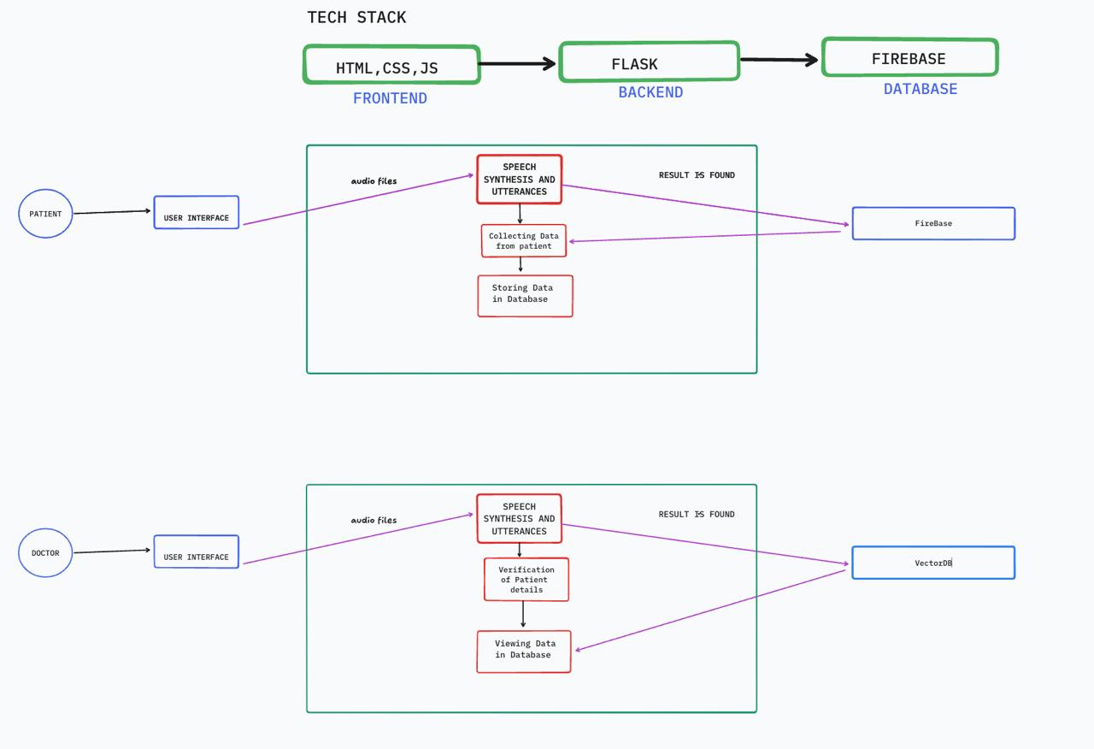
Proposed Architecture

Slide 20
Modules Identified
User Registration and Authentication Module:
Allows patients to create accounts, log in securely, and manage their profiles.
Ensures data privacy and security through authentication protocols.
Patient Information Input Module:
-Facilitates the entry of personal information, medical history, current medications, allergies, and family health history.
-Provides user-friendly forms or interfaces for data entry.
Symptom Assessment Module:
Guides patients through a series of questions to assess their current symptoms and concerns.
Utilizes branching logic to tailor questions based on previous answers.
Data Validation and Error Checking Module:
Ensures that the information entered by patients is complete and accurate.
Provides prompts for missing information or inconsistencies.

Slide 21
Algorithm (Depending on the Project)
Natural Language Processing (NLP) Algorithms:
Tokenization: Breaking down text into individual words or phrases for analysis.
Named Entity Recognition (NER): Identifying and classifying key entities in the text, such as patient names, medical conditions, medications, and dates.
Text Classification: Categorizing text data into predefined classes, such as identifying the type of medical issue or urgency level.
Part-of-Speech Tagging: Identifying the grammatical parts of speech in a sentence to understand the structure and meaning.
Transformers: Models like BERT (Bidirectional Encoder Representations from Transformers) and GPT (Generative Pre-trained Transformer) are used for understanding context in text data and generating human-like responses.

Slide 22
Implementation work
Develop System Architecture: Design the overall architecture of the automated system, including data flow, storage, and integration points with existing systems.
Ensure Compliance: Implement necessary security measures to protect patient data and ensure compliance with relevant regulations.
Data Migration: Plan and execute the migration of existing patient data into the new system, ensuring data integrity and accuracy.
API Integration: Utilize application programming interfaces (APIs) to connect the automated system with existing EHRs, telehealth platforms, and other relevant systems.

Slide 23
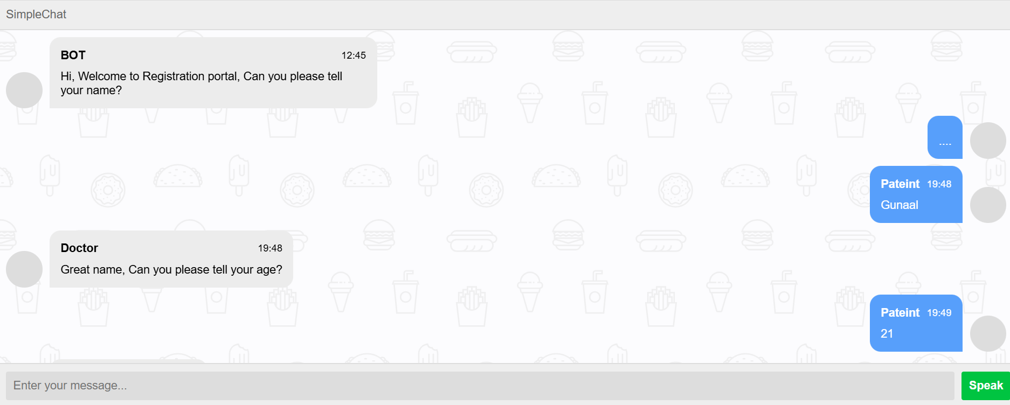
Results-Implementation Screenshots

Slide 24
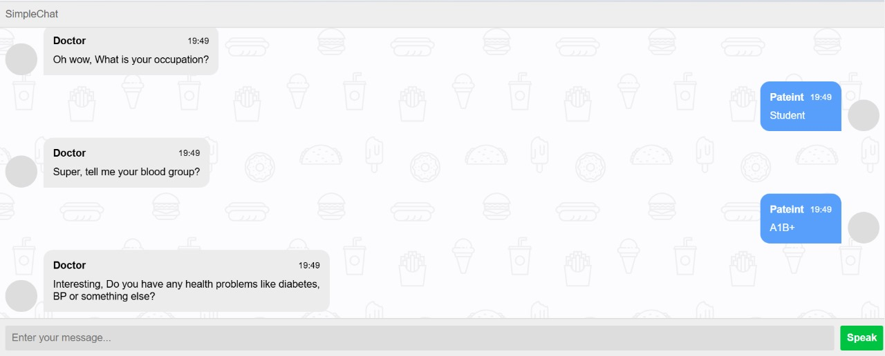
Results-Implementation Screenshots

Slide 25
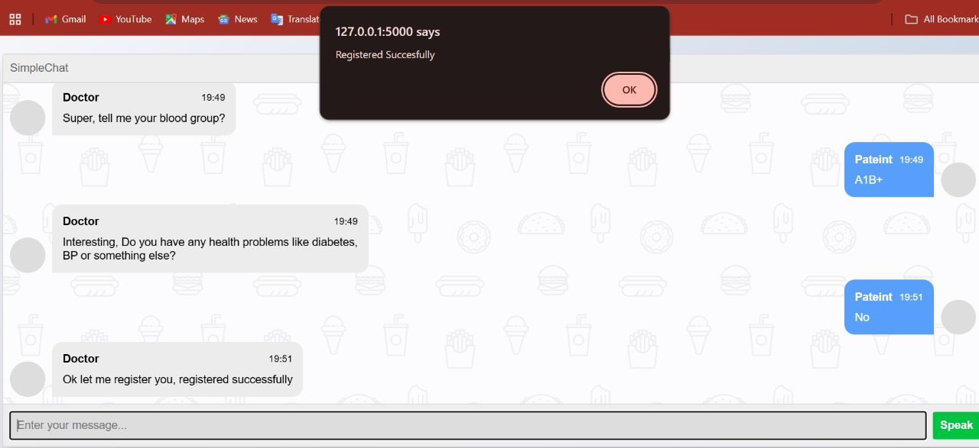
Results-Implementation Screenshots

Slide 26
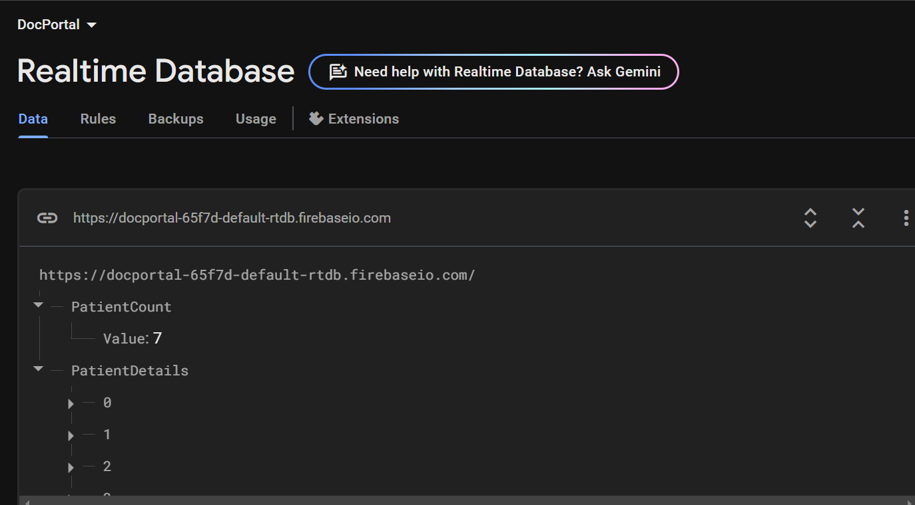
Results-Implementation Screenshots

Slide 27
Software and Hardware Requirements
SOFTWARE REQUIREMENTS:
Operating System: Windows.
Programming Language: Python.
Database: Firebase.
IDE: Visual Studio Code.
HARDWARE REQUIREMENTS:
Processor: Any Processor above 500 MHZ.
RAM: 8GB.
Hard Disk: 500GB.
Input device: Standard Keyboard and Mouse.
Output Device: VGA and Monitor.

Slide 28
References
[1] Gulnur Zhakhina1,2, Karina Tapinova.Pre-consultation history taking systems and their impact on modern practices: Advantages and limitations. Journal Of Clinical Medicine Of Kazakhstan. IEEE Journal. 2023.
[2] Wenxing Hong 1 , Ziang Xiong1 , Nannan Zheng1 , and Yang Weng. A Medical-History-Based Potential Disease Prediction Algorithm. IEEE Journal Access.2019.
[3] P. William; Yogeesh N; Vishal M Tidake. Framework for Implementation of Personality Inventory Model on Natural Language Processing with Personality Traits Analysis.IEEE ACCESS conference.2022.
[4] María D. Illescas-Manzano , Noé Vicente López . Implementation of Chatbot in Online Commerce, and Open Innovation. IEEE Journal.2023.
[5] Alessandro Mazzei;Luca Ansemia. Anticipating User Interactions in customer care dialogue system.IEEE ACCESS conference.2021.
[6] Asoke Nath , Rupamita Sarkar , Swastik Mitra, Rohitaswa Pradhan.Designing and Implementing Conversational Intelligent Chat-bot Using Natural Language Processing.IEEE Journal. 2022.
[7] Ganesh Reddy Gunnam. Assessing Performance of Cloud-Based Heterogeneous Chatbot Systems and A Case Study. IEEE Journal Access. 2024.
[8] Taisei Takahashi,Yan Zhihao,Kazumasa Omote. Emergency Medical Access Control System Based on Public Blockchain. Springer. 2024.

Slide 29
[9] Marco Polignano. HealthAssistantBot: A Personal Health Assistant for the Italian Language. IEEE Journal Access.2020.
[10] Mohd Asif Shah. An AI-Based Medical Chatbot Model for Infectious Disease Prediction. IEEE Journal Access.2022.
[11] Hendry Naufal Marbella, Izzat Aulia Akbart, Bambang Setiawan.Design and development of a web-based patient management information system. Elsevier. 2023.
[12] Giada Confortala , Mika Takata , Naoaki Yokoi, and Masashi Egi.Enhancing Predictive Models to Lower Rehospitalization Risk: Utilizing Historical Medical Records for AI-Driven Interventions . IEEE Journal Access.2024.
[13] Hendry Naufal Marbella, Izzat Aulia Akbar†, Bambang Setiawan.Secure System Medical Record with Blockchain System: Recchain Framework. IEEE Journal Access. 2024.
[14] Joseph Finkelstein , Aileen Gabriel, Susanna Schmer, Andrew Dunn.Identifying Facilitators and Barriers to Implementation of AI‑Assisted Clinical Decision Support in an Electronic Health Record System. Springer.2024.
[15] Giacomo Scaioli, Manuela Martella, Giuseppina Lo Moro1. Knowledge, Attitudes, and Practices about Electronic Personal Health Records: A Cross-Sectional Study in a Region of Northern Italy. Springer. 2024.

Slide 30
[16] Lanyun Zhang , Jiani Zhan, Verena Kwok Wai Wan, And Yanbin Wang. Designing and Evaluating Online Health Consultation Interfaces: A Perspective of Physician-Patient Power Asymmetry .IEEE Journal.2024.
[17] Maisie Wang,C. Lau,Frederick A. Matsen,Yongmin Kim.Personal health information management system and its application in referral management. IEEE Journal Access.2004.
[18] Joseph Finkelstein , Aileen Gabriel, Susanna Schmer, Andrew Dunn. Meaningful use of patient-centric health records for healthcare transformation.IEEE Journal. 2012.
[19] Manuel Gil1 , Reemel Sherif2 , Manon Pluye2 , Benjamin C. M. Fung 1 , (Senior Member, IEEE), Roland Grad2 , and Pierre Pluye2.Towards a Knowledge-Based Recommender System for Linking Electronic Patient Records With Continuing Medical Education Information at the Point of Care . IEEE Journal Access.2019.
[20] Peter Adebowale Olujimi and Abejide Ade-Ibijola.NLP Techniques for automating responses to customer quries:A systematic Review. Springer.2023.

Slide 31
Publication status
TITLE: CAREBOT : PATIENT HISTORY AUTOMATION
Authors Name: A.Sowbarnika, Gunaal T, Vasanth R, Alex Rayer A.
Conference Name: International Conference on ‘Computing, STEM and Applied Sciences’
(ICCSIS -2025).
Organized by: B. K. Birla College, Kalyan, Maharashtra, India.
Conference Date: 21th - 22th Mar 2025.
Conference Status: Abstract accepted and Paper Submitted.

